Slide 1
Lecture 5: Protein Folding & Structure Prediction

Slide 2
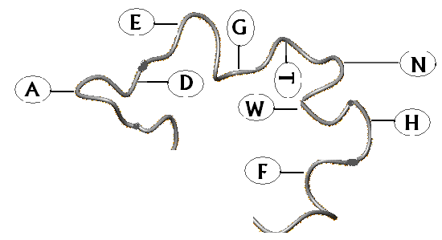
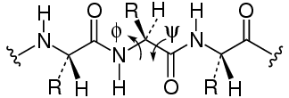
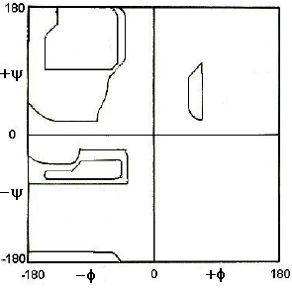
Polypeptide Chain
Invariant Backbone
Variant Side chain
Conformationally constrained chain due to the planarity of the peptide bond
Conformational variables: dihedral angles
Local organization restricted to two - alpha helices and beta sheets
Global organization restricted to only ~1000 variants
β
α
Restricted Access (~21%)

Slide 3
Protein Folding Problem
PF Problem is the difficulty in predicting a three-dimensional structure of a protein from its amino acid sequence.
How does a protein fold into its prescribed functional structure?

Slide 4
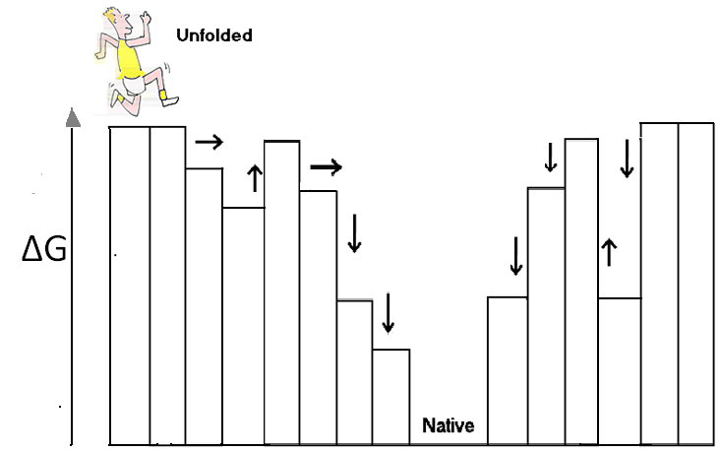
The three dimensional structure of a native protein in its normal physiological conditions is the one in which Gibbs free energy of the whole system is the lowest; that is native conformation is determined by the totality of inter-atomic interactions and hence amino acid sequence
----Thermodynamic hypothesis, Anfinsen 1973

Slide 5
Levinthal’s Paradox
We assume that there are three conformations for each amino acid (ex. α-helix, β-sheet and random coil). If a protein is made up of 100 amino acid residues, a total number of conformations is
3¹⁰⁰ = 515377520732011331036461129765621272702107522001 ≒ 5 x 10⁴⁷.
If 100 psec (10⁻¹⁰ sec) were required to convert from a conformation to another one, a random search of all conformations would require
5 x 10⁴⁷ x 10⁻¹⁰ sec ≒ 1.6 x 10³⁰ years.
However, folding of proteins takes place in milli second to second order. Therefore, proteins fold not via a random search but a more sophisticated search process.
We want to watch the folding process of a protein using molecular simulation techniques.

Slide 6
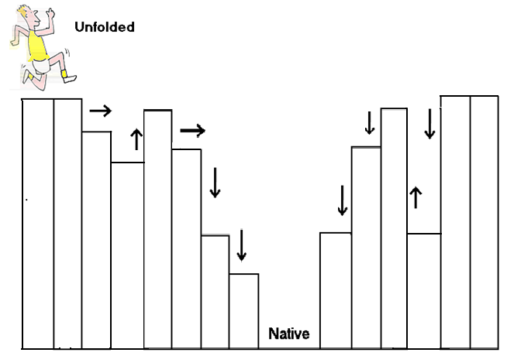
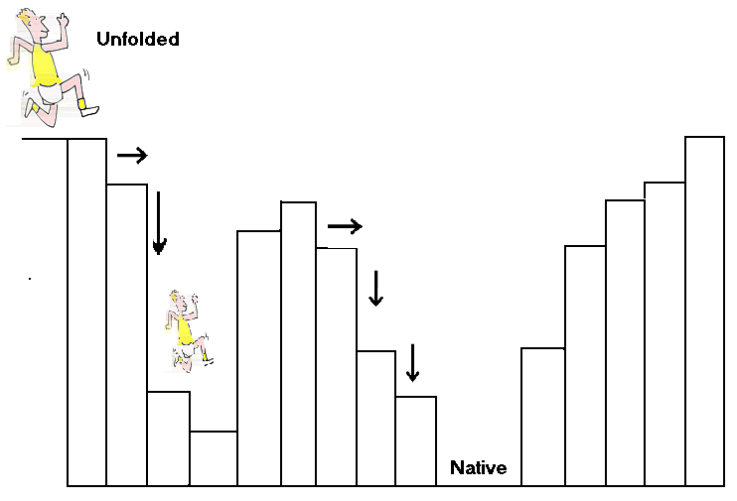
t < 1sec
Kinetic Trap
Only a tiny fraction of total possible conformations available to a polypeptide chain can be sampled during folding; the subset of conformations can be viewed as a kinetic Pathway.
-----Kinetic hypothesis, Levinthal 1968
Kinetic trap along the pathway slows down folding, and if such large TS barrier is for the folded state, such proteins have high degree of kinetic stability

Slide 7
Difficulty in studying Protein Folding:
From the view point of computer simulation,
It is difficult to simulate the whole process of protein folding at atomistic level using even state-of-the-art computers.
It is uncertain whether the accuracy of current energy functions and parameters are sufficient for protein folding simulation or not.
…, let me recount a conversation with Francis in 1975 (who won the Novel prize for discovering the structure of DNA). Crick stated that "it is very difficult to conceive of a scientific problem that would not be solved in the coming twenty years … except for a model of brain function and protein folding". Although Crick was more interested in brain function, he did state that both problems were difficult because they involve many cooperative interactions in three-dimensional space.
(Levitt M, “Through the breach.” Curr. Opin. Struct. Biol. 1996, 1, 193-194)
Courtesy: Tokyo University of Science Tadashi Ando

Slide 8
Understanding Protein mis-folding pathways
Multiple
intermediate states
through
multiple pathways
funneled towards
stable native state
Intra-molecular Vs Inter-molecular
Understanding the kinetic mechanism of misfolding and aggregation.
Explore the effect of mutations (sequence and topological) on folding pathways
Jahn and Radford, FEBS, 2005

Slide 9
Importance or Protein Folding
Proteins play important roles in living organisms.
Some proteins are deeply related with diseases. And structural information of a protein is necessary to explain and predict its gene function as well as to design molecules that bind to the protein in drug design.
Today, whole genome sequences (the complete set of genes) of various organisms have been deciphered and we realize that functions of many genes are unknown and some are related with diseases.
Therefore, understanding of protein folding helps us to investigate the functions of these genes and to design useful drugs against the diseases efficiently.
In addition to that, the understanding opens the door to designing of proteins having novel functions as new nano machines.
Courtesy: Tokyo University of Science Tadashi Ando

Slide 10
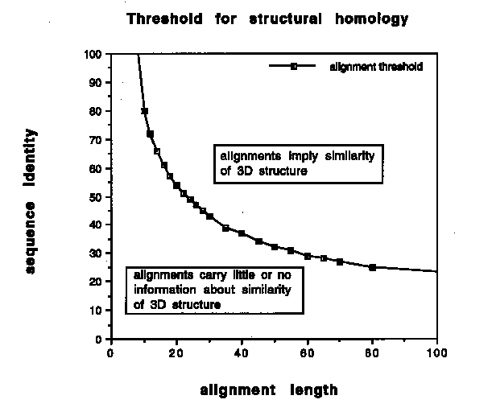
Homology Modeling
Safe zone
Twilight zone

Slide 11
Homology Modeling …simple
Template Recognition and initial alignment
V A T T P D K S W L T V
A S T P E R A S W L G T A
V A T T P D K _ S W L T V _
_ A S T P E R A S W L G T A
* Residues with similar proerties in green
_ is a gap

Slide 12
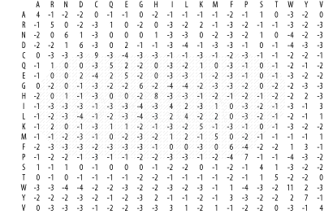
Homology Modeling
Residue Exchange matrix !!!!

Slide 13
Homology Modeling
Alignment Correction
L T L T L T L T
Y A Y A Y A Y A
Poor possibilities of alignment
L T L T L T L T
T Y T Y T Y T Y
Y A Y A Y A Y A
Concept …of Multiple Sequence Alignment

Slide 14
Homology Modeling
Loop modeling
Good News: Conformational change wont happen within regular secondary structural elements.
So its safe to shift all insertions or deletions in the alignment out of helices and strands.
Bad News: Loops are notoriously difficult to predict.
Possible problems:
Surface loops tend to be involved in crystal contacts…
Exchange of small with bulky sidechains underneath the group pushes it aside
Mutation of loop residue to pro or from ala to pro restrict their respective Ramachandran space considerably

Slide 15
Homology Modeling
Loop modeling approaches:
Knowledge based: Search PDB with endpoints that match the residues between the loop and copy the loop conformation
Energy based: ab initio fold prediction with an energy function, MD, MC etc

Slide 16
Principles of Molecular Modelling

Slide 17
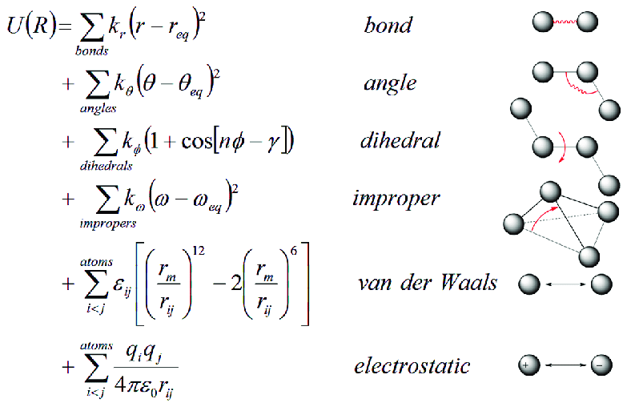
Force Field

